Slide 1
Technological Advancements in Filmmaking: A Case Study Analysis
CSCI 4960 Introduction to Research | Kevin Shreenauth 08/11/2024

Slide 2
Introduction

Slide 3
MOTIVATION AND BACKGROUND
Passion for Film
Pursuit of Minor in Video, Performance, and Social Practice
Desire to Highlight Connections Between the World of Technology and the world of Film Production

Slide 4
RESEARCH OBJECTIVE
To investigate the role technology has in both the physical filmmaking process and post-production software in the past, present, and future through the respective technological advancements made and their impacts on the filmmaking process.

Slide 5
RESEARCH QUESTION
How have technological advancements impacted the world of filmmaking, both in the physical hardware used to film motion pictures and the software technologies used in post-production?

Slide 6
KEY DEFINITIONS
Film Hardware → Camera, Lighting, Audio Equipment, etc.
Film Software → Editing, AI algorithms, CGI, VR/AR, Animation, etc.
Post-Production → Technology used to edit pre-recorded film

Slide 7
METHODS AND DATA
The Research is Divided into a Literature Review and a Comparative Case Study

Slide 8
METHODS AND DATA
Literature Review looks at Innovations in Past, Present, and Future:
Past: Physical Filmmaking Through the Director Arc of Ang Lee
Present: Animation, AI, and Visual Effects Through various Films
Future: Virtual Reality Through VPET

Slide 9
METHODS AND DATA (RESEARCH CONTRIBUTION)
Research Contribution is Demonstrated through a Self-Conducted Comparative Case Study that compares Avatar (2009) and District 9 (2009). The Study Comparison is based on:
Behind-the-scenes footage
Budget vs. Film Performance at the Box Office
Quality and Efficiency of the Final Product

Slide 10
Literature Review

Slide 11
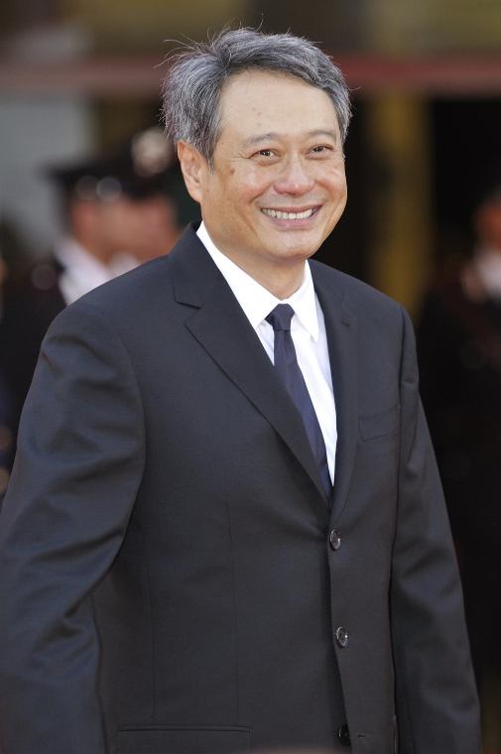


PAST – PHYSICAL FILMMAKING & ANG LEE’S DIRECTOR ARC
Transition from Film to Digital Cameras
Reduced costs, increased flexibility
Crouching Tiger, Hidden Dragon (2000)
Advanced CGI
Life of Pi (2012)
High Frame Rate Capture Technology
Billy Lynn’s Long Halftime Walk (2016)

Slide 12
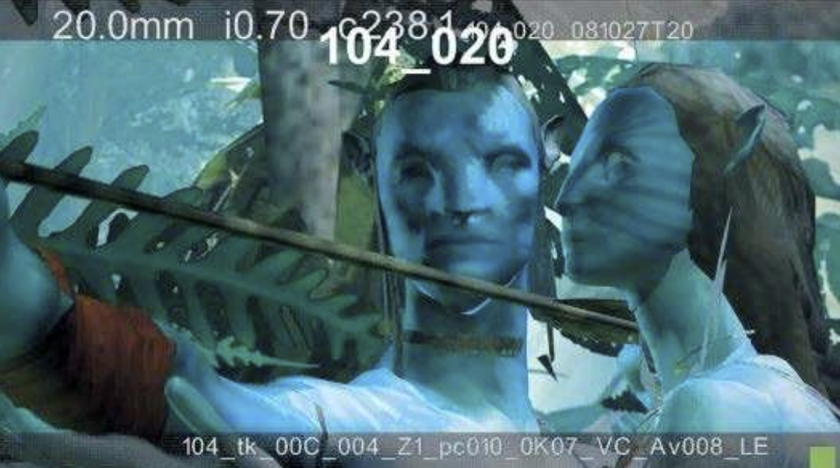
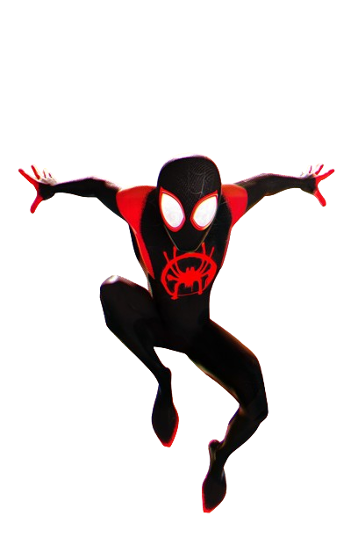
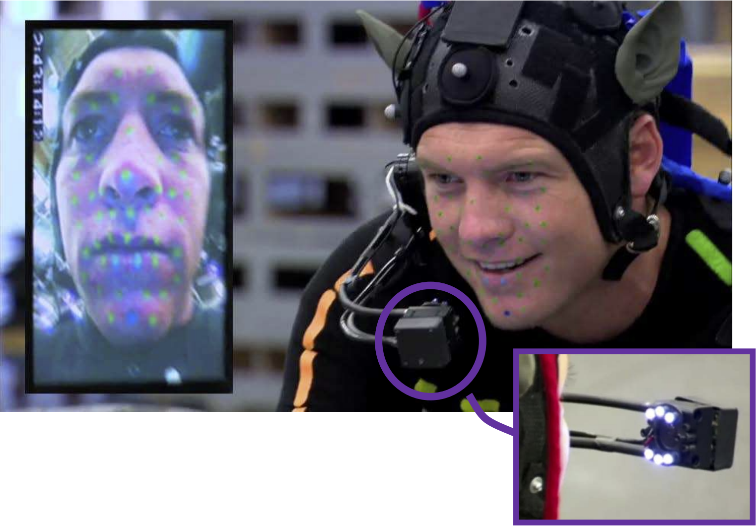
PRESENT – ANIMATION, AI, VISUAL EFFECTS
Technological Integration
CGI, Animation, and AI have transformed visual storytelling
Enhanced realism and efficiency in productions
Animation, VFX Technologies
Avatar (2009)
District 9 (2009)
Spider-Man: Into the Spider-Verse (2018)

Slide 13
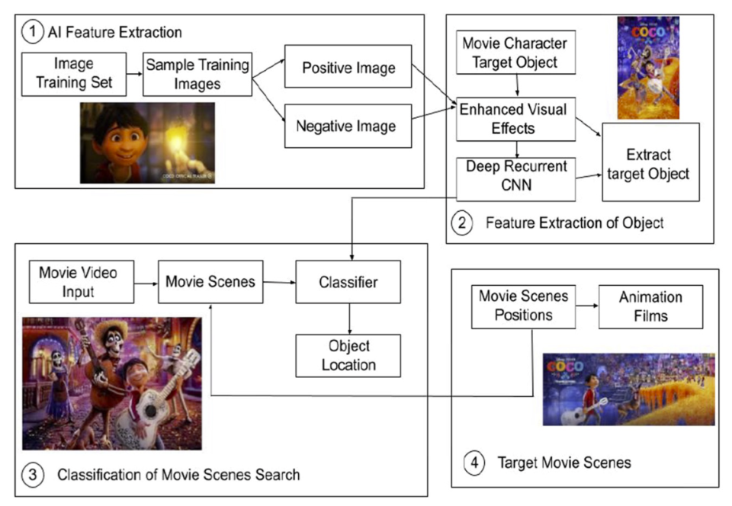
PRESENT – ANIMATION, AI, VISUAL EFFECTS
AI
Scripting Technologies
AI Scene Identification Algorithms in Post-Production Software

Slide 14
FUTURE – VIRTUAL REALITY INNOVATIONS
Virtual and Augmented Reality promise to further revolutionize filmmaking
Offers Immersive Production Techniques and Interactive Viewing Experiences
VPET [Virtual Production Editing Tool]
Invented for Directors to Edit a Film In a Virtual Space

Slide 15
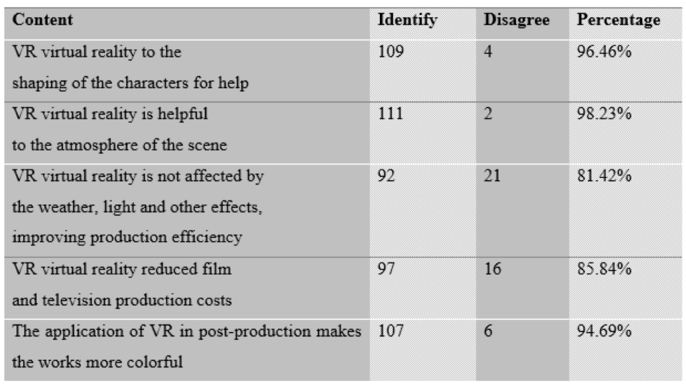
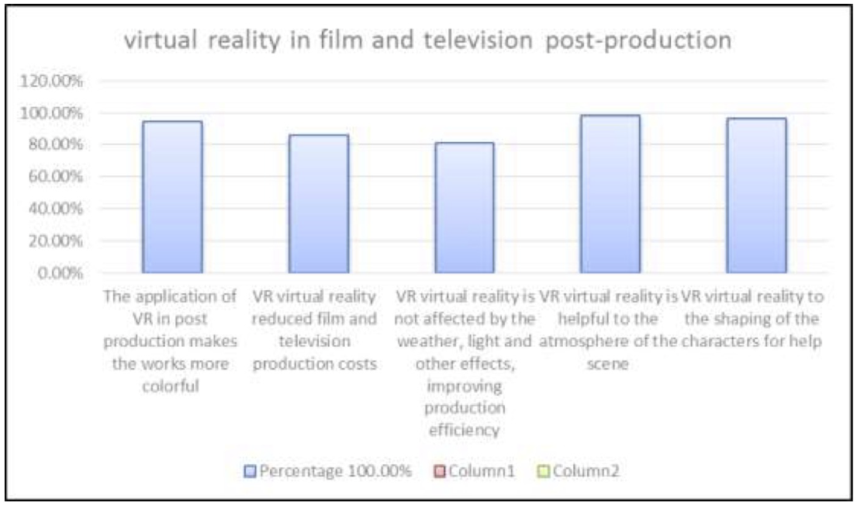
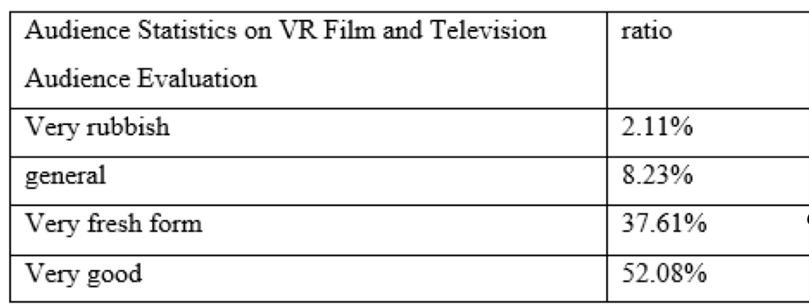
FUTURE – VIRTUAL REALITY INNOVATIONS

Slide 16
Comparative Case Study

Slide 17
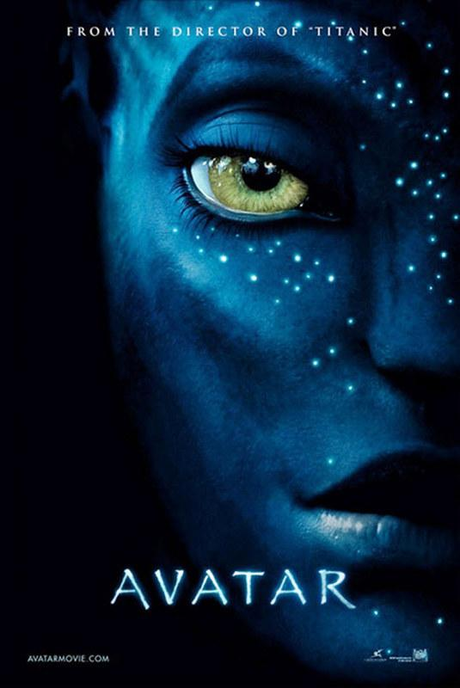

COMPARATIVE CASE STUDY

Slide 18
COMPARATIVE CASE STUDY – AVATAR (2009)
The invention of the Simulcam specifically for Avatar allowed for CGI to be melded into the physical filmmaking process
They also had access to bigger facilities to do full CGI work (with green and blue screens).
Advanced motion capture technology allowed the actor’s full body motions and facial expressions to be mapped onto a character created in CGI.

Slide 19
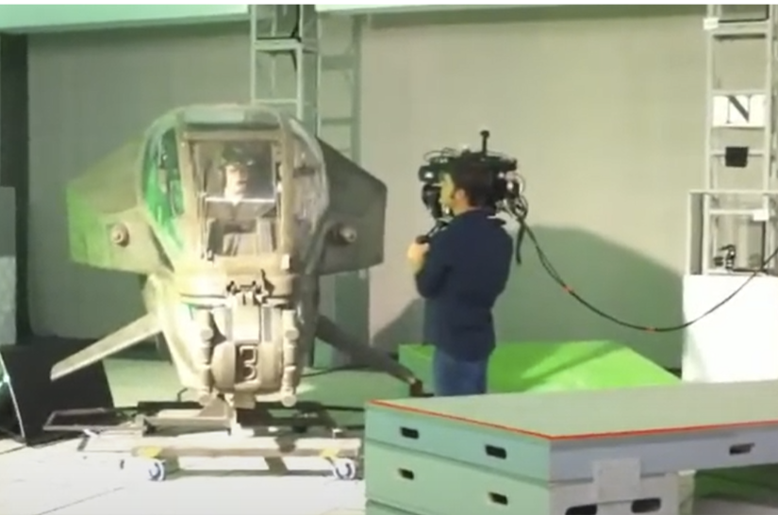
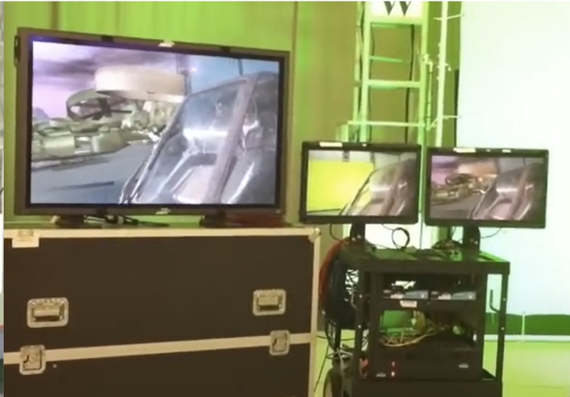
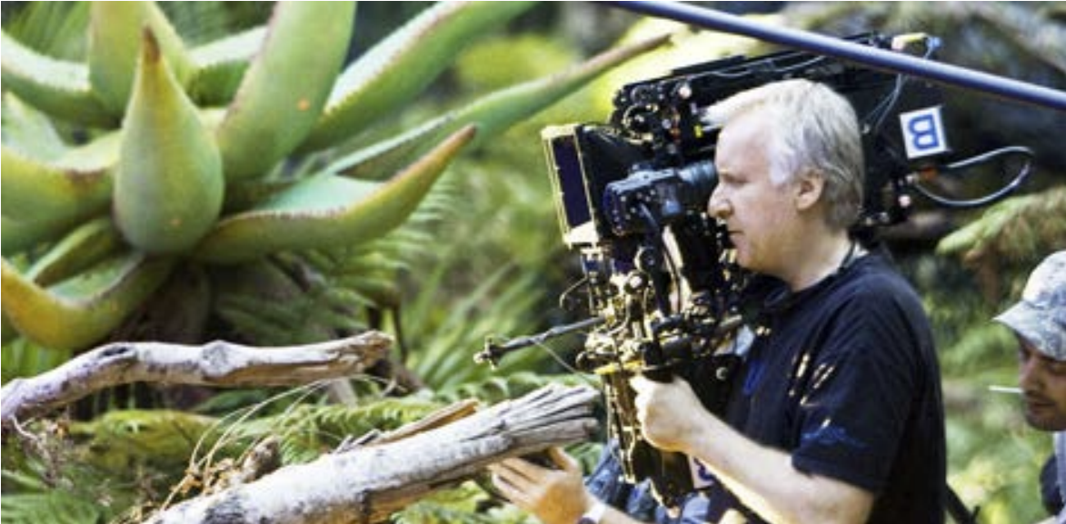
COMPARATIVE CASE STUDY – AVATAR (2009)

Slide 20
COMPARATIVE CASE STUDY – DISTRICT 9 (2009)
District 9 had significantly of a less budget, so more traditional methods of CGI were used mainly in post production
The physical filmmaking process was mixed with:
Filming on Live Locations
Using Prosthetics
Documentary-Style Shots with Lower Quality Cameras

Slide 21
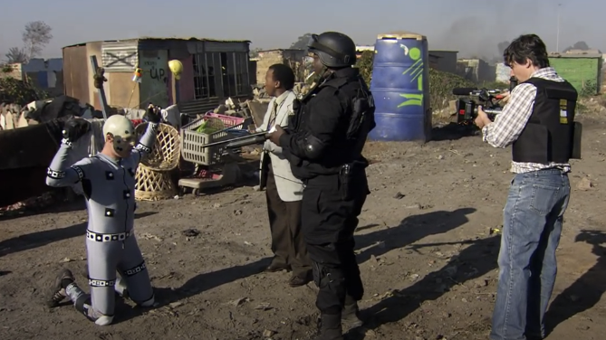
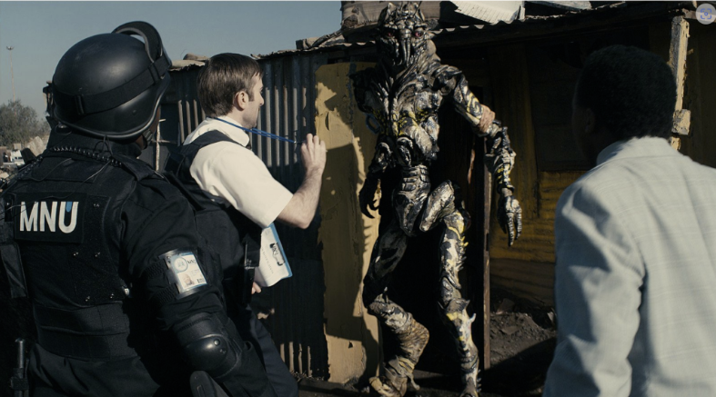

COMPARATIVE CASE STUDY – DISTRICT 9 (2009)

Slide 22
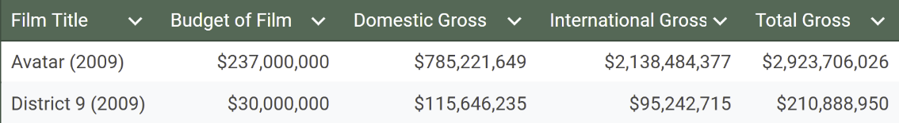
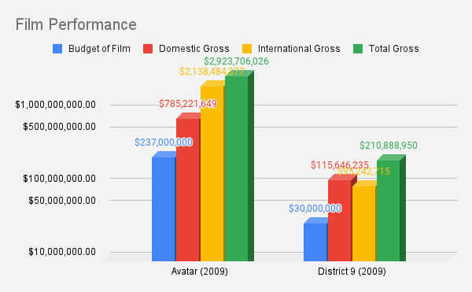
COMPARATIVE CASE STUDY - ANALYSIS
The results from the figure demonstrate that Avatar having access to better types of CGI and 3D technology with their bigger budget allowed them to perform higher in the box office.
However, despite the lack of outreach, sources from experts say District 9 still performed extremely well given the limit budget. The use of creative and more traditional film techniques saved the film’s ability to engage audiences.

Slide 23
Conclusion

Slide 24
CONCLUSION
The evolution from physical film to digital cameras and the integration of CGI, animation, and AI have revolutionized filmmaking, enhancing creative possibilities and production efficiency.
Emerging technologies like VR and AR promise to further transform the industry, opening new avenues for storytelling.
The comparative analysis of "Avatar" and "District 9" illustrates the diverse ways technology can enhance filmmaking, providing valuable insights for future projects.

Slide 25
ACKNOWLEDGMENTS
Thank you to Professor Keshan for her guidance and support and the peers of CSCI 4960 Introduction to Research that provided constructive feedback to better this research.

Slide 26
References
Photograph of Ang Lee at the 85th Annual Oscars press room. (n.d.). AceShowbiz. http://www.aceshowbiz.com/images/wennpic/ang-lee-85th-annual-oscars-press-room-02.jpg
Ming, X. M. (2022). Post-production of digital film and television with development of virtual reality image technology-advance research analysis. Int. J. Mech. Eng, 7.
Apple Inc. (2023). Music cover image. Apple Music. https://is1-ssl.mzstatic.com/image/thumb/Music124/v4/b5/2e/cd/b52ecdf1-353b-0ffb-36f1-e378e99998cd/886443609716.jpg/1200x1200bf-60.jpg
Animatrik Film Design. (n.d.). Behind the scenes of one of the most iconic sci-fi films of our times: The making of District 9. Animatrik. Retrieved from https://www.animatrik.com/blog/behind-the-scenes-of-one-of-the-most-iconic-sci-fi-films-of-our-times-the-making-of-district-9
AMC Theatres. (n.d.). Spider-Man: Into the Spider-Verse [Image]. Retrieved July 25, 2024, from https://www.amctheatres.com/movies/spider-man-into-the-spider-verse-48153 All Games Network. (2023, June 14).
The Impact of CGI in Modern Filmmaking [Video]. YouTube. https://www.youtube.com/watch?v=lyHa_0yJBlw&t=115s&ab_channel=AllGamesNetwork
The 14 Amazons. (n.d.). Crouching Tiger, Hidden Dragon [Movie poster]. Retrieved August 12, 2024, from https://the14amazons.co.uk/m276-Crouching_Tiger_Hidden_Dragon

Slide 27
Thank You
Any Questions?

